Slide 1
Data exploration and client-side analytics in a custom 2D web app
Dev Summit 2020 Plenary Session
Kristian Ekenes

Slide 2
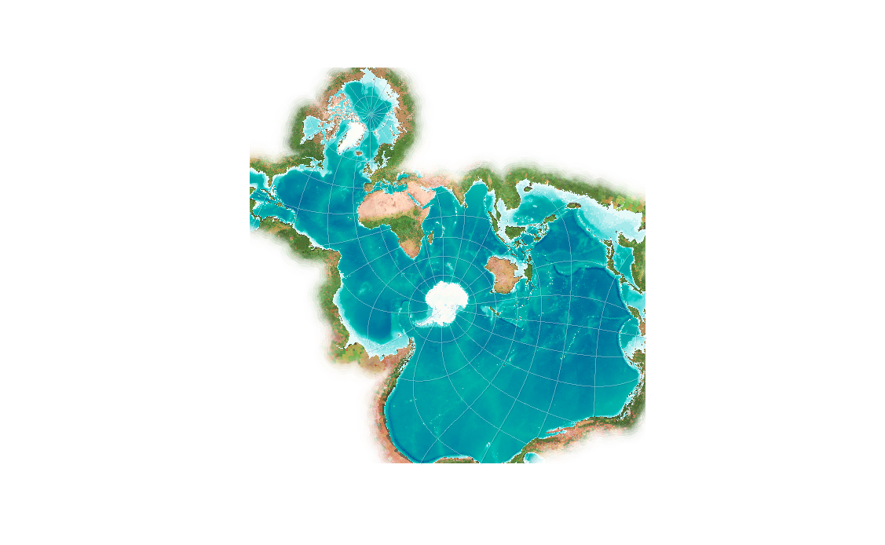
The JS API allows you to render your data in hundreds of coordinate systems such as this one, the Spilhaus projection, a conformal projection that depicts the world’s ocean as a single body of water. This makes it an ideal choice for exploring oceanic data.

Slide 3
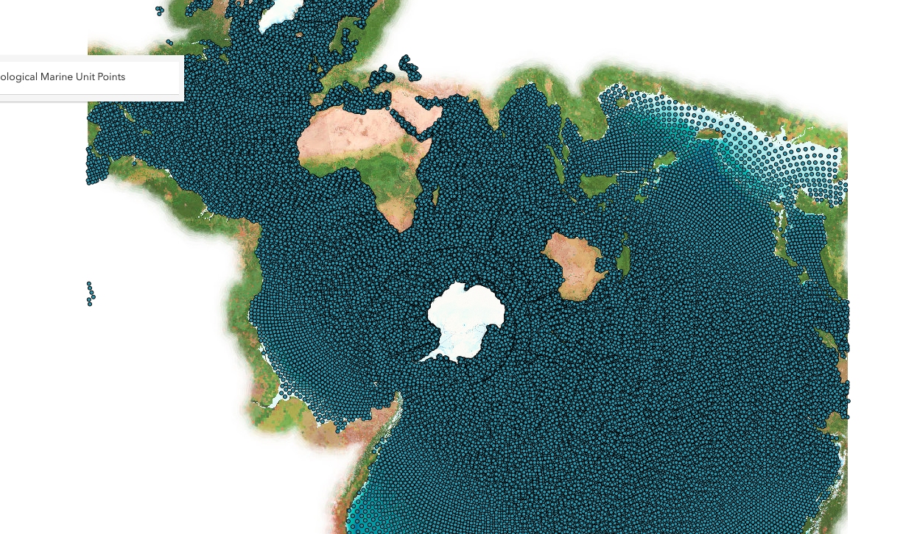
I downloaded a subset of points from Esri’s open Ecological Marine Unit dataset. And displayed it in this project. Let’s visualize this dataset to extract some meaning from it.

Slide 4
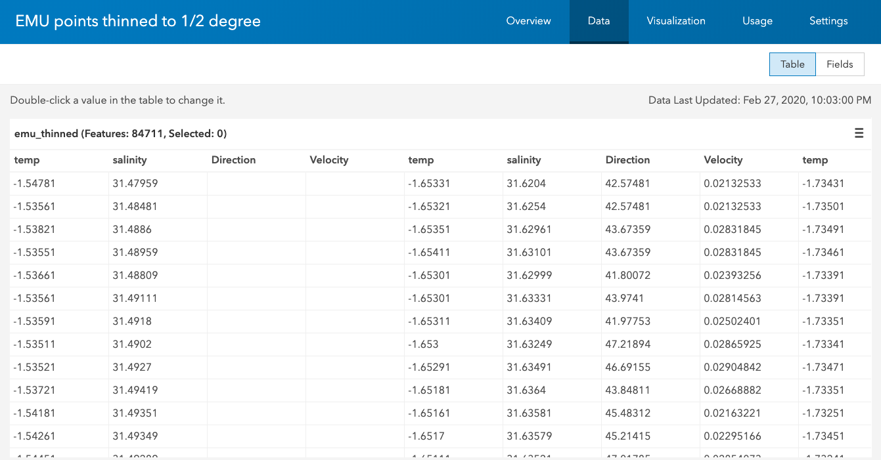
Each row in our dataset indicates the x,y location of of sample point, and each column represents a temperature or salinity value at various depths for the given point. This results in a massive table containing hundreds of columns.

Slide 5
In this app I download and display the open ecological marine unit data provided by Esri, to explore some temperature and salinity using sample points in the world’s oceans.
This is not a tile layer or an image.
[hover pointer over the points]
this is a feature layer I’ve styled with a continuous color renderer to visualize salinity. As the user moves the cursor over each point, I execute a client-side query and render the results in the scatter plot to the left to view how salinity varies at each point at various depths of the ocean. We can achieve this fast performance because the query executes against our client-side query engine.

Slide 6
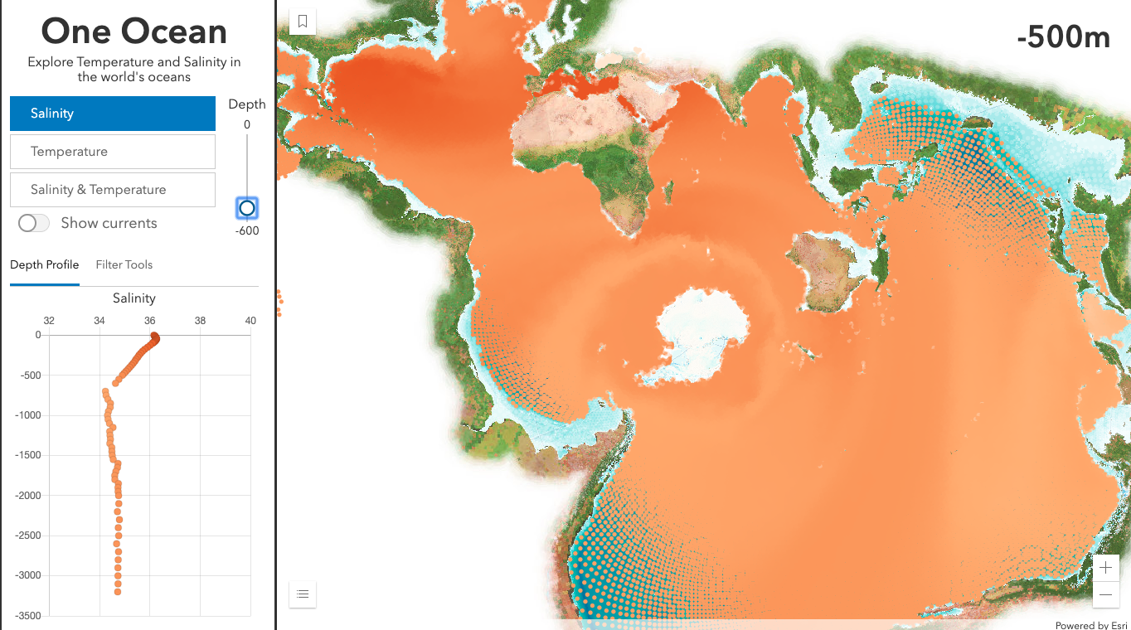
[Move the depth slider]
I’ve also configured a vertical slider to allow the user to update the renderer to point to salinity values for a particular depth.
This may look like an update to the color ramp, or a client-side filter, but none of those things are happening. Instead I’m changing the field name. Since the data for all these fields already exists on a texture in the GPU, we can update the visualization without having to reprocess the geometries.

Slide 7
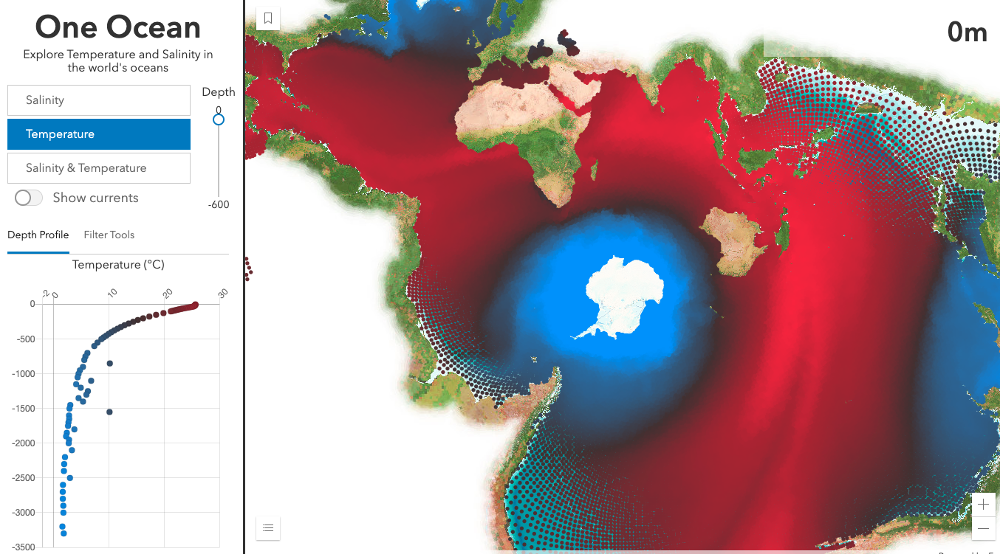
[switch to temp]
Even when I switch variables – say to temperature – The renderer handles the updates very quickly without noticeable flashing.

Slide 8
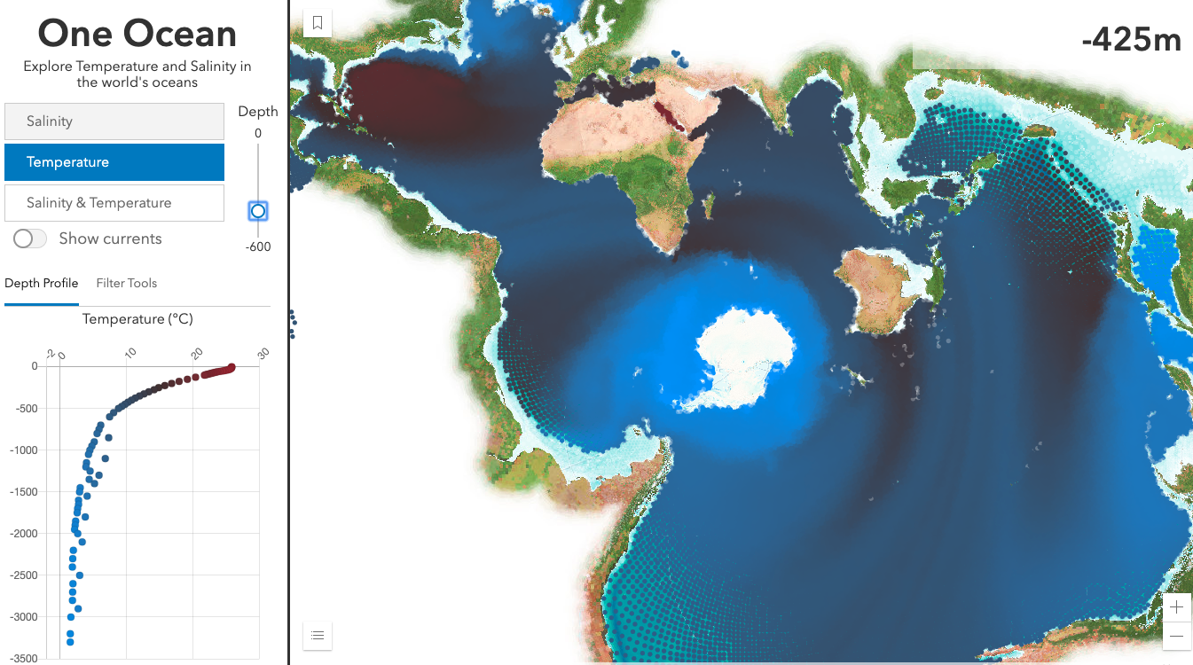
[use depth slider]

Slide 9
This layer contains two additional variables – direction and velocity – that can be used to view ocean currents in relation to this data.
I’ll use a size visual variable to indicate the speed of the current at each location, and a rotation variable to indicate the direction of the flow.
Since a circle isn’t suited for mapping direction, I’ll need a different symbol type.

Slide 10
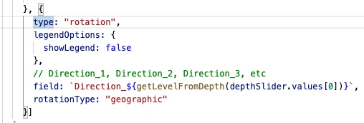
I set a rotation visual variable and set it to the appropriate direction field based on the selected depth value.
This renderer will update every time the user moves the depth slider and switches the selected variable.

Slide 11
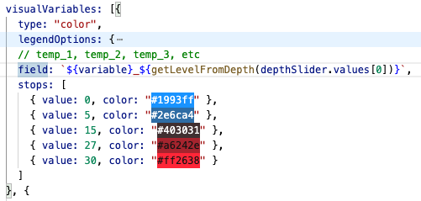
The field referenced by each visual variable is updated based on a slider value. Note the color values and data ranges remain constant, so the GPU can look up to a new data value without reprocessing the geometries.

Slide 12
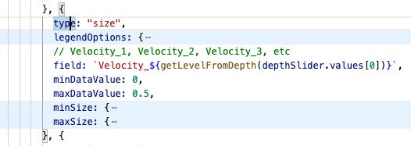
Similarly I update the size of each icon based on the corresponding value in the Velocity field for the given depth.
But this variable is slightly different…

Slide 13
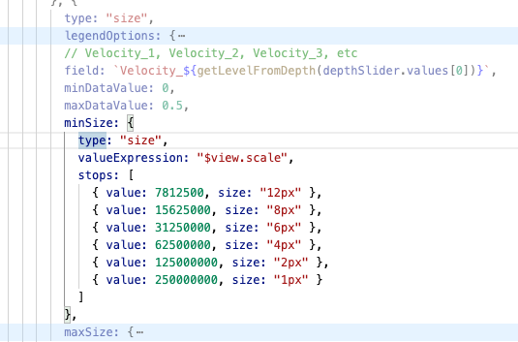
Instead of assigning a fixed size to the ranges, I can vary symbol size not only by data value, but by scale using an Arcade expression.

Slide 14
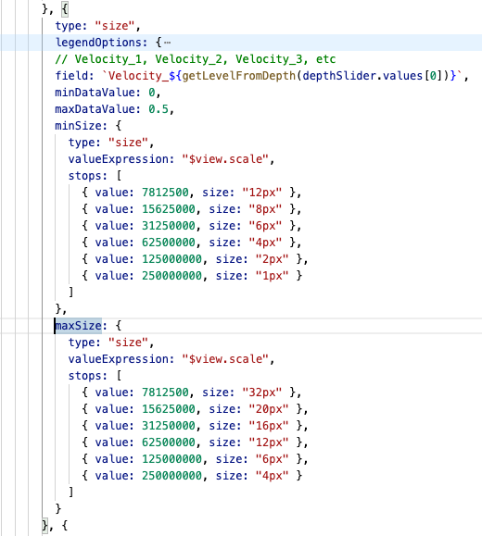
So I can ensure the icons are visible and easily understood by the user as they zoom in and out.

Slide 15
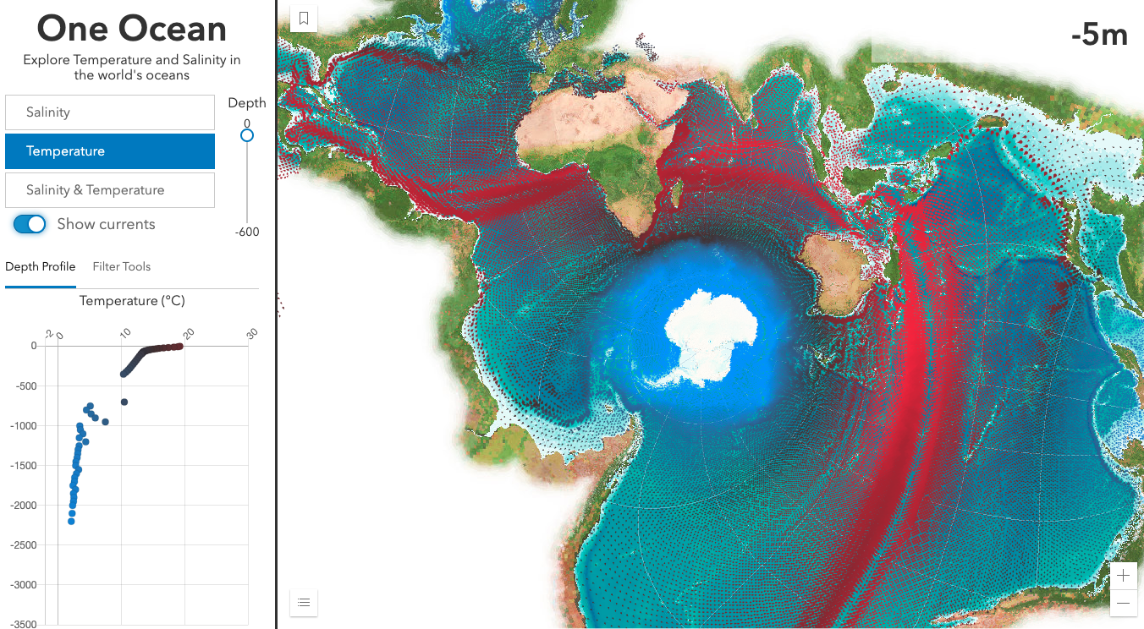
[Toggle show currents]
When I toggle the “show currents” switch, the new size and rotation variables are applied to the renderer and I can immediately see patterns of strong currents, where they are warm, etc.

Slide 16
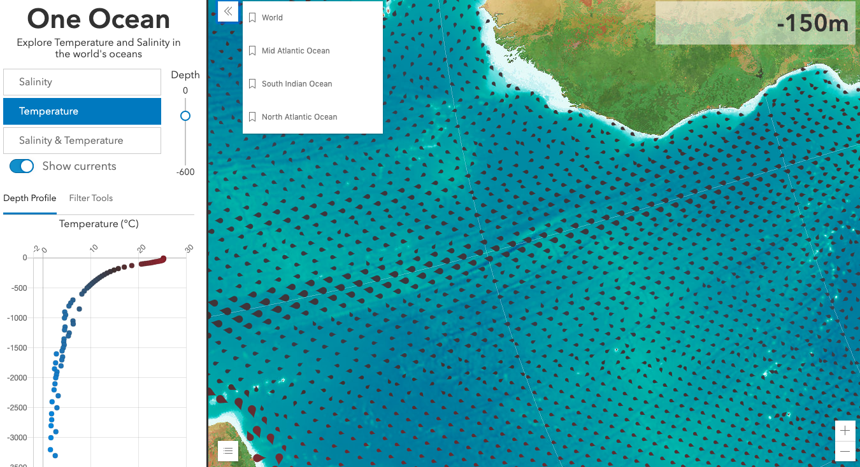
[zoom to Mid Atlantic Ocean]
[Slide the depth slider]
As I zoom in, you’ll notice the size of the icons grows so I can get a better view of the direction of flow.
Notice how fast the renderer updates as I update the depth…all these variables change instantly. I can even see how not only the temperature and speed of the currents changes as you drop in depth, but the direction also changes in the same x/y locations as you go deeper.

Slide 17
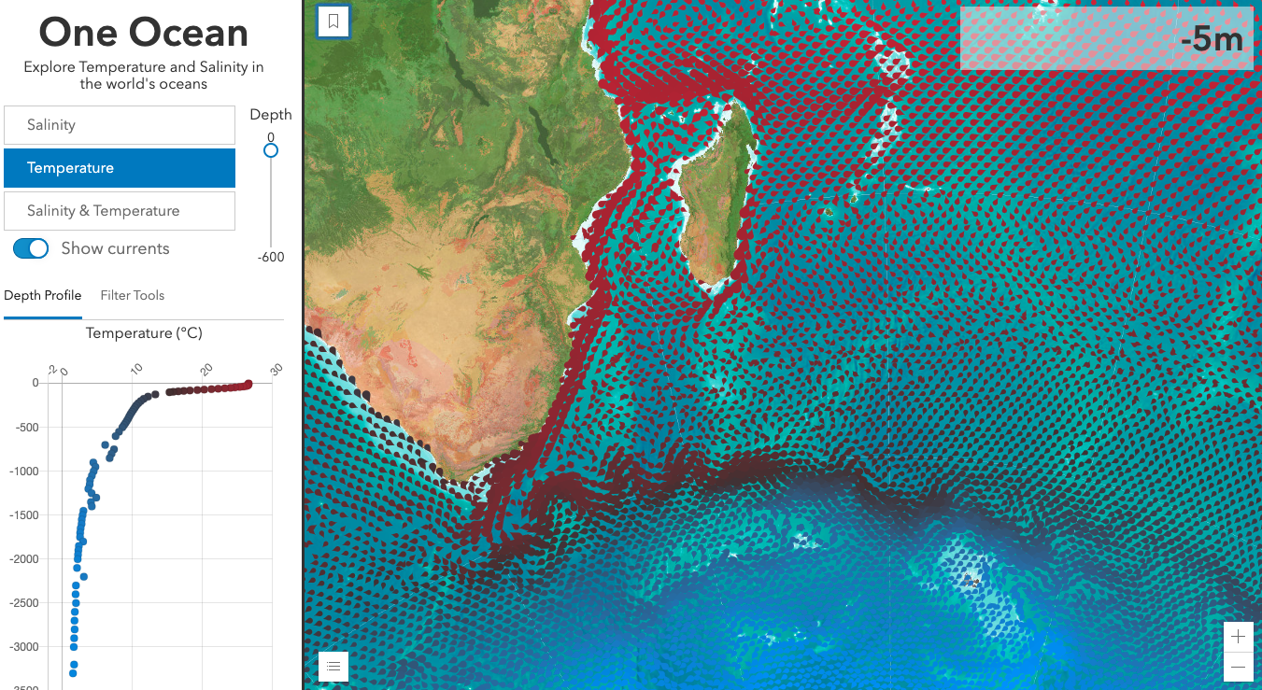
Let’s move to where the South Indian Ocean meets the Southern Ocean. I can see an area where a warm current meets cold water.

Slide 18
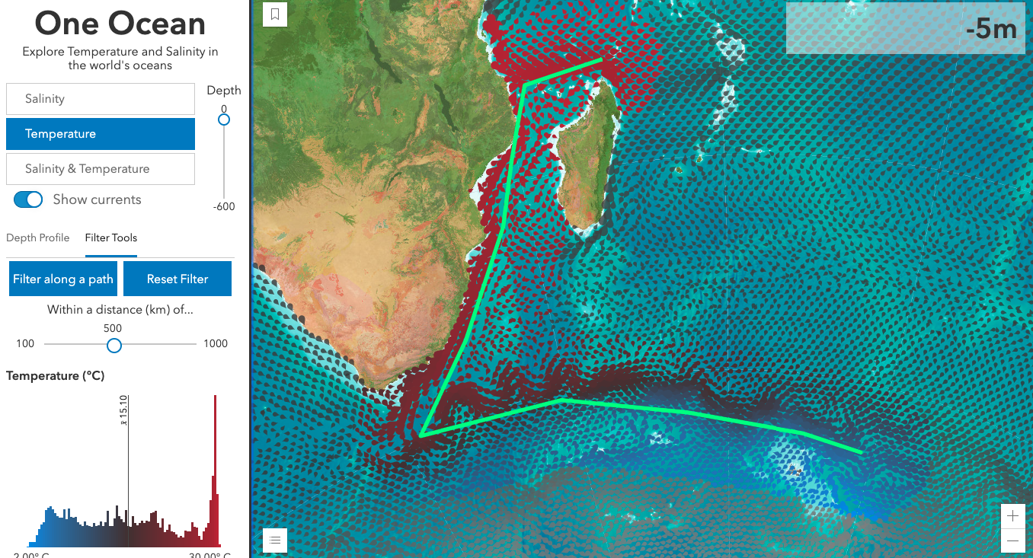
I want to view a smaller area of my data. I added a tool that allows the user to sketch a path and query all data within a distance of that path.
As they draw the path, the app generates a histogram, whose colors match the values of the points for that depth.

Slide 19
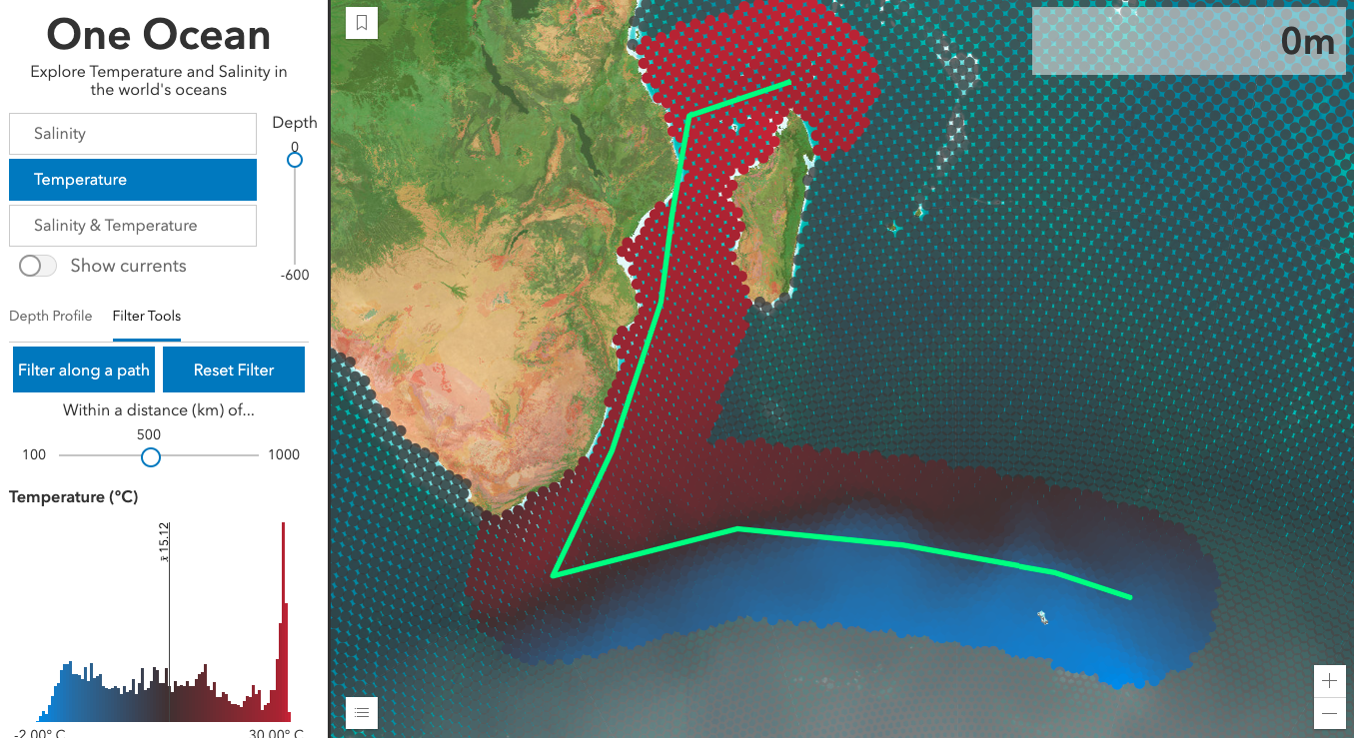
I set a filter on the data and style the points excluded from the filter with a feature effect, to subdue them. That way I can still see there’s data in those locations, but they aren’t of concern in my analysis.

Slide 20
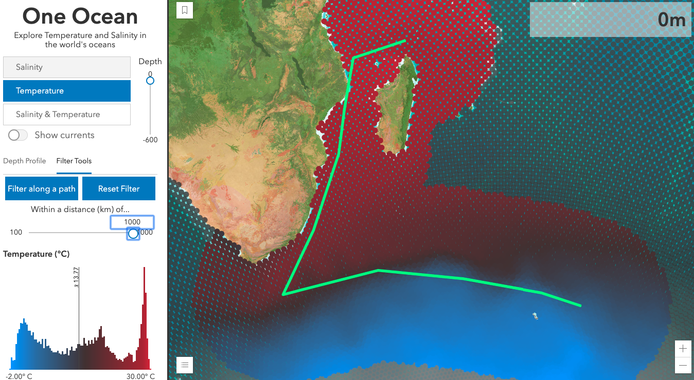
As the user increases or decreases the distance, and changes the desired depth, both the filter and the histogram instantly update without flashing, making this a smooth experience for the user.

Slide 21
Conclusion
As I’ve showed you this app, I hope you’ve caught the vision of how web mapping is evolving. It’s no longer about static presentation-style apps with a simple popup. Thanks to the vast performance improvements made over the last year, you can now bring more data to the browser more efficiently than ever before so you can build powerful, interactive apps for client-side data exploration and analytics.

